Slide 1


Zaw Aung
14/06/2025

Slide 2
Outline
Executive Summary
Introduction
Methodology
Results
Conclusion
Appendix

Slide 3
Executive Summary
Summary of methodologies
Data Collection through API
Data Collection with Web Scraping
Data Wrangling
Exploratory Data Analysis with SQL
Exploratory Data Analysis with Data Visualization
Interactive Visual Analytics with Folium
Machine Learning Prediction
Summary of all results
Exploratory Data Analysis result
Interactive analytics in screenshots
Predictive Analytics result

Slide 4
Introduction
Project background and context
Space X advertises Falcon 9 rocket launches on its website with a cost of 62 million dollars; other providers cost upward of 165 million dollars each, much of the savings is because Space X can reuse the first stage. Therefore, if we can determine if the first stage will land, we can determine the cost of a launch. This information can be used if an alternate company wants to bid against space X for a rocket launch. This goal of the project is to create a machine learning pipeline to predict if the first stage will land successfully.
Problems you want to find answers
What factors determine if the rocket will land successfully?
The interaction amongst various features that determine the success rate of a successful landing.
What operating conditions needs to be in place to ensure a successful landing program.

Slide 5

Section 1

Slide 6
Methodology
Executive Summary
Data collection methodology:
Data was collected using SpaceX API and web scraping from Wikipedia.
Perform data wrangling
Filtering data and dealing with missing values
One-hot encoding was applied to categorical features
Perform exploratory data analysis (EDA) using visualization and SQL
Perform interactive visual analytics using Folium and Plotly Dash
Perform predictive analysis using classification models
Building, tuning and evaluation of classification models to ensure the best results

Slide 7

Data Collection – SpaceX API
We used the get request to the SpaceX API to collect data
Decoded response using .json() and convert into dataframe with .json_normalize()
Applied custom functions on data and made dictionary
Made dataframe from dictionary
Filtered dataframe to only have flacon 9 launches
Calculated mean of PayloadMass column
Replaced missing values from PayloadMass column with mean
Exported dataframe to CSV
The link to the notebook is Data Collection

Slide 8

Data Collection – Web Scraping
Used get request to obtain Falcon 9 launch data from Wikipedia
Created BeautifulSoup object from HTML response
Extracted all column names from HTML table header
Collected all data by parsing HTML tables and into a dictionary
Create dataframe from dictionary
Export dataframe to CSV
The link to the notebook is Web Scraping

Slide 9
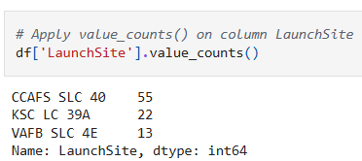
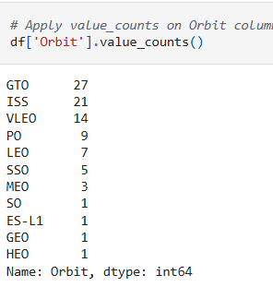
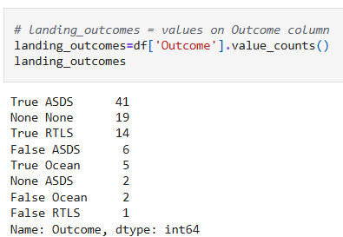
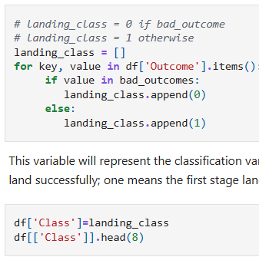
Data Wrangling
Perform Exploratory Data Analysis and determine Training Labels Calculated the number of launches on each site
Calculated the number and occurrence of each orbit
Calculated the number and occurrence of mission outcome per orbit type
Created a landing outcome label from Outcome column
Exported the dataframe to CSV
The link to the notebook is Data Wrangling

Slide 10


EDA with Data Visualization
Charts were plotted:
Flight Number vs. Payload Mass, Flight Number vs. Launch Site, Payload Mass vs. Launch Site, Orbit Type vs. Success Rate, Flight Number vs. Orbit Type,Payload Mass vs Orbit Type and Success Rate Yearly Trend
Scatter plots show the relationship between variables. If a relationship exists, they could be used in machine learning model.
Bar charts show comparisons among discrete categories. The goal is to show the relationship between the specific categories being compared and a measured value.
Line charts show trends in data over time (time series).
Link to the notebook Data Visualisation

Slide 11
EDA with SQL
We loaded the SpaceX dataset into a PostgreSQL database without leaving the jupyter notebook.
We applied EDA with SQL to get insight from the data.
Displaying the names of the unique launch sites in the space mission
Displaying 5 records where launch sites begin with the string ‘CCA'
Displaying the total payload mass carried by boosters launched by NASA (CRS)
Displaying average payload mass carried by booster version F9 v1.1
Listing the date when the first successful landing outcome in ground pad was achieved
Listing the names of the boosters which have success in drone ship and have payload mass greater than 4000 but less than 6000
Listing the total number of successful and failure mission outcomes
Listing the names of the booster versions which have carried the maximum payload mass
Listing the failed landing outcomes in drone ship, their booster versions and launch site names for the months in year 2015
Ranking the count of landing outcomes (such as Failure (drone ship) or Success (ground pad)) between the date 2010-06-04 and 2017-03-20 in descending order.
The link to the notebook is EDA with SQL

Slide 12

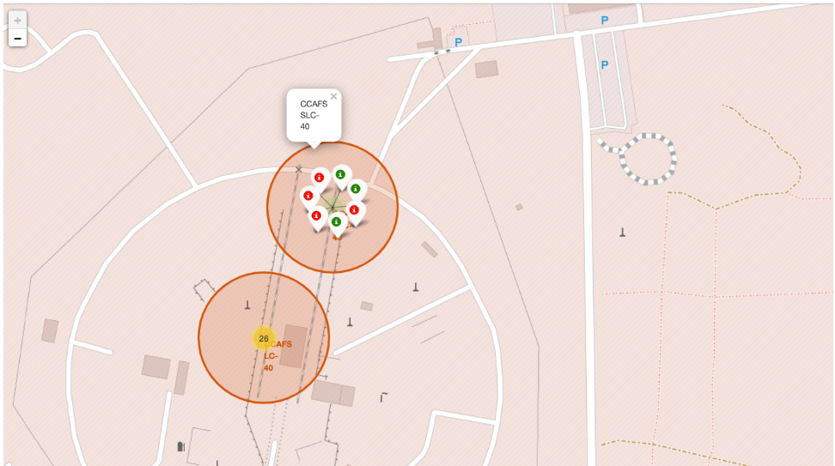
Build an Interactive Map with Folium
We marked all launch sites, and added map objects such as markers, circles, lines to mark the success or failure of launches for each site on the folium map.
We assigned the feature launch outcomes (failure or success) to class 0 and 1.i.e., 0 for failure, and 1 for success.
Using the color-labeled marker clusters, we identified which launch sites have relatively high success rate.
We calculated the distances between a launch site to its proximities. We answered some question for instance:
Are launch sites near railways, highways and coastlines.
Do launch sites keep certain distance away from cities.
Link to the notebook Interactive map with Folium

Slide 13
Build a Dashboard with Plotly Dash
Launch Sites Dropdown List: -
Added a dropdown list to enable Launch Site selection.
Pie Chart showing Success Launches (All Sites/Certain Site): -
Added a pie chart to show the total successful launches count for all sites and the Success vs. Failed counts for the site, if a specific Launch Site was selected.
Slider of Payload Mass Range: -
Added a slider to select Payload range.
Scatter Chart of Payload Mass vs. Success Rate for the different Booster Versions: -#
Added a scatter chart to show the correlation between Payload and Launch Success.
Link to the notebook Link to Plotly Dash App

Slide 14
Predictive Analysis (Classification)
Created a NumPy array from the column “Class” in data
Standardised the data with StandardScaler, then fitting and transforming it
Splitting the data into training and testing sets with train_test_split function
Created a GridSearchCV object with cv = 10 to find the best parameters
Applied GridSearchCV on LogReg, SVM, Decision Tree, and KNN models
Calculating the accuracy on the test data using the method .score() for all models
Examining the confusion matrix for all models
Finding the method performs best by examining the Jaccard_score and F1_score metrics
The link to the notebook is Machine Learning Prediction

Slide 15
Results
Exploratory data analysis results
Interactive analytics demo in screenshots
Predictive analysis results

Slide 16

Section 2

Slide 17
EDA with Visualization

Slide 18

Flight Number vs. Launch Site
• The earliest flights all failed while the latest flights all succeeded.
• The CCAFS SLC 40 launch site has about a half of all launches.
• VAFB SLC 4E and KSC LC 39A have higher success rates.
• It can be assumed that each new launch has a higher rate of success.

Slide 19
Payload vs. Launch Site
For every launch site the higher the payload mass, the higher the success rate.
Most of the launches with payload mass over 7000 kg were successful.
KSC LC 39A has a 100% success rate for payload mass under 5500 kg too.

Slide 20

Success Rate vs. Orbit Type
Orbits with 100% success rate: - ES-L1, GEO, HEO, SSO
Orbits with 0% success rate: - SO
Orbits with success rate between 50% and 85%: - GTO, ISS, LEO, MEO, PO

Slide 21

Flight Number vs. Orbit Type
In the LEO orbit the Success appears related to the number of flights; on the other hand, there seems to be no relationship between flight number when in GTO orbit.

Slide 22

Payload Mass vs. Orbit Type
Heavy payloads have a negative influence on GTO orbits and positive on GTO and Polar LEO (ISS) orbits.

Slide 23
Launch Success Yearly Trend
From the plot, we can observe that success rate since 2013 kept on increasing till 2020.

Slide 24
EDA with SQL

Slide 25

All Launch Site Names
Displaying the names of the unique launch sites in the space mission.
We used the key word DISTINCT to show only unique launch sites from the SpaceX data.

Slide 26

Launch Site Names Begin with 'CCA'
Used the query above to display 5 records where launch sites begin with `CCA`

Slide 27

Total Payload Mass
Displaying the total payload mass carried by boosters launched by NASA (CRS).
The total payload carried by boosters from NASA calculated as 45596 using the query below

Slide 28
Average Payload Mass by F9 v1.1
Calculated the average payload mass carried by booster version F9 v1.1 as 2534

Slide 29

First Successful Ground Landing Date
Observed that the dates of the first successful landing outcome on ground pad was 22nd December 2015

Slide 30

Successful Drone Ship Landing with Payload between 4000 and 6000
Listing the names of the boosters which have success in drone ship and have payload mass greater than 4000 but less than 6000.
Used the WHERE clause to filter for boosters which have successfully landed on drone ship and applied the AND condition to determine successful landing with payload mass greater than 4000 but less than 6000

Slide 31

Total Number of Successful and Failure Mission Outcomes
Used wildcard LIKE ‘%’ to filter for WHERE MissionOutcome was a success or a failure.

Slide 32

Boosters Carried Maximum Payload
We determined the booster that have carried the maximum payload using a subquery in the WHERE clause and the MAX() function.

Slide 33

2015 Launch Records
We used a combinations of the WHERE clause, LIKE, AND, and BETWEEN conditions to filter for failed landing outcomes in drone ship, their booster versions, and launch site names for year 2015

Slide 34

Rank success count between 2010-06-04 and 2017-03-20
Selected Landing outcomes and the COUNT of landing outcomes from the data and used the WHERE clause to filter for landing outcomes BETWEEN 2010-06-04 to 2010-03-20.
Applied the GROUP BY clause to group the landing outcomes and the ORDER BY clause to order the grouped landing outcome in descending order.

Slide 35

Section 3

Slide 36
Interactive map with Folium

Slide 37
All launch sites global map markers
• Most of Launch sites are in proximity to the Equator line. The land is moving faster at the equator than any other place on the surface of the Earth. Anything on the surface of the Earth at the equator is already moving at 1670 km/hour. This speed will help the spacecraft keep up a good enough speed to stay in orbit.
• All launch sites are in very close proximity to the coast, while launching rockets towards the ocean it minimises the risk of having any debris dropping or exploding near people.

Slide 38
Markers showing launch sites with color labels
• From the colour-labeled markers we should be able to easily identify which launch sites have relatively high success rates.
Green Marker = Successful Launch
Red Marker = Failed Launch
• Launch Site KSC LC-39A has a very high Success Rate.

Slide 39

Launch Site distance to landmarks

Slide 40

Section 4

Slide 41
Build a Dashboard with Plotly Dash

Slide 42

Pie chart showing the success percentage achieved by each launch site

Slide 43
Pie chart showing the Launch site with the highest launch success ratio
KSC LC-39A has the highest launch success rate (76.9%) with 10 successful and only 3 failed landings.

Slide 44
Payload Mass vs. Launch Outcome for all sites
The charts show that payloads between 2000 and 5500 kg have the highest success rate.

Slide 45

Section 5

Slide 46
Predictive analysis (Classification)

Slide 47
Classification Accuracy
• Based on the scores of the Test Set, we can not confirm which method performs best.
• Same Test Set scores may be due to the small test sample size (18 samples). Therefore, we tested all methods based on the whole Dataset.
• The scores of the whole Dataset confirm that the best model is the Decision Tree Model. This model has not only higher scores, but also the highest accuracy.
Scores and Accuracy of the Test Set
Scores and Accuracy of the Entire Data Set

Slide 48

Confusion Matrix
The confusion matrix for the decision tree classifier shows that the classifier can distinguish between the different classes.
The major problem is the false positives .i.e., unsuccessful landing marked as successful landing by the classifier.

Slide 49
Conclusions
Decision Tree Model is the best algorithm for this dataset.
Launches with a low payload mass show better results than launches with a larger payload mass.
Most of launch sites are in proximity to the Equator line and all the sites are in very close proximity to the coast.
The success rate of launches increases over the years.
KSC LC-39A has the highest success rate of the launches from all the sites.
Orbits ES-L1, GEO, HEO and SSO have 100% success rate.

Slide 50
Appendix
Include any relevant assets like Python code snippets, SQL queries, charts, Notebook outputs, or data sets that you may have created during this project

Slide 51


